Slide 1
NONPARAMETRIC INFERENCE PROJECT -WILCOXON MANN-WHITNEY STATISTIC
PROJECT GUIDE : Dr. ISHA DEWAN
ROLL No. 4 ANISHA GHOSH
ROLL NO. 14 PARAMITA ADHIKARI
ROLL NO. 15 PAYEL GHOSAL

Slide 2
INTRODUCTION :
Starting from the parametric inference study we know that for two independent normal samples the most popular test for location shift is Fisher t-test . Now for nonparametric case the two sample location problem is tackled by Mann-Whitney U Test . There is another test called Wilcoxon Rank-Sum Test but it is almost same as Mann-Whitney U test .

Slide 3
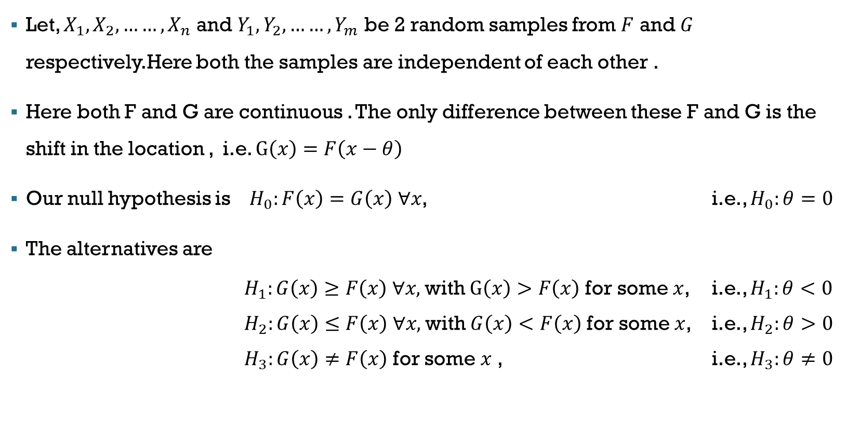
Basic Setup :
Let, $X_{1}, X_{2},……,X_{n}$ and $Y_{1}, Y_{2},……, Y_{m}$ be 2 random samples from $F$ and $G$ respectively.Here both the samples are independent of each other .
Here both F and G are continuous . The only difference between these F and G is the shift in the location , i.e. $G\left(x\right)=F\left(x−θ\right)$
Our null hypothesis is $H_{0}:F\left(x\right)=G\left(x\right) ∀x$, i.e., $H_{0}:θ=0$
The alternatives are
$H_{1}:G\left(x\right)≥F\left(x\right) ∀x,$with $G\left(x\right)>F\left(x\right)$ for some $x$, i.e., $H_{1}:θ<0$
$H_{2}:G\left(x\right)≤F\left(x\right) ∀x,$with $G\left(x\right)<F\left(x\right)$ for some $x$, i.e., $H_{2}:θ>0$
$H_{3}:G\left(x\right)≠F\left(x\right)$ for some $x$ , i.e., $H_{3}:θ≠0$

Slide 4
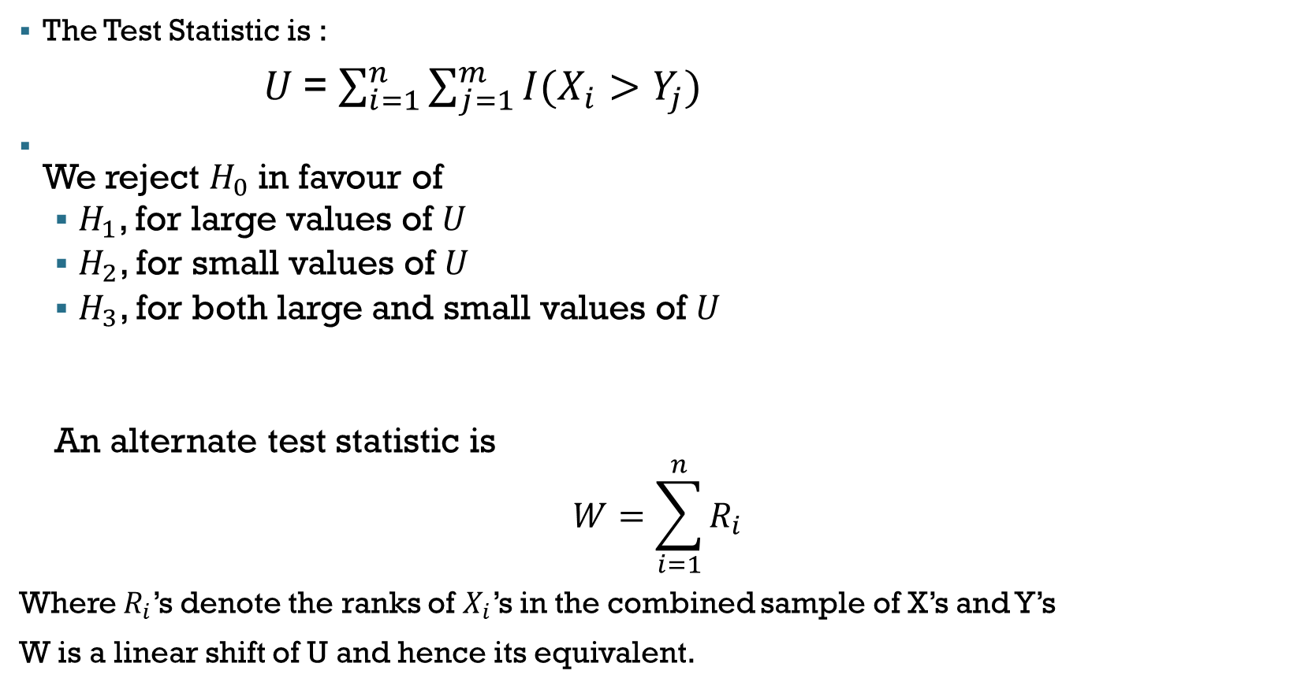
The Test Statistic is :
$U$= $\sum_{i=1}^{n}{\sum_{j=1}^{m}{I(X_{i}>Y_{j})}}$
We reject $H_{0}$in favour of
$H_{1}$, for large values of $U$
$H_{2}$, for small values of $U$
$H_{3}$, for both large and small values of $U$
An alternate test statistic is
$$W=\sum_{i=1}^{n}{R_{i}}$$
Where $R_{i}$’s denote the ranks of $X_{i}$’s in the combined sample of X’s and Y’s
W is a linear shift of U and hence its equivalent.

Slide 5
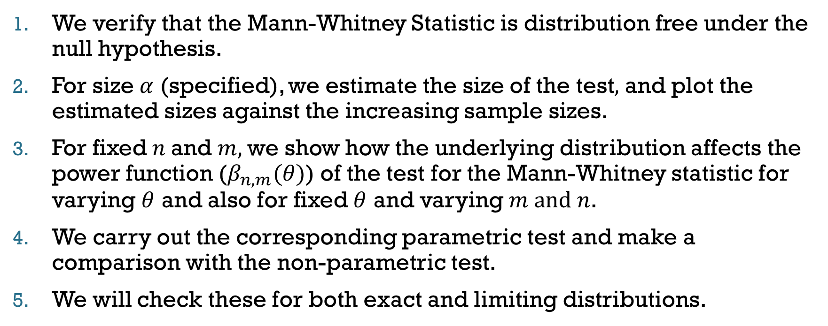
objective
We verify that the Mann-Whitney Statistic is distribution free under the null hypothesis.
For size $α$ (specified), we estimate the size of the test$,$ and plot the estimated sizes against the increasing sample sizes.
For fixed $n$and $m,$we show how the underlying distribution affects the power function ($β_{n,m}(θ)$) of the test for the Mann-Whitney statistic for varying $θ$ and also for fixed $θ$ and varying $m and n$.
We carry out the corresponding parametric test and make a comparison with the non-parametric test.
We will check these for both exact and limiting distributions.

Slide 6
DISTRIBUTION OF STATISTIC

Slide 7
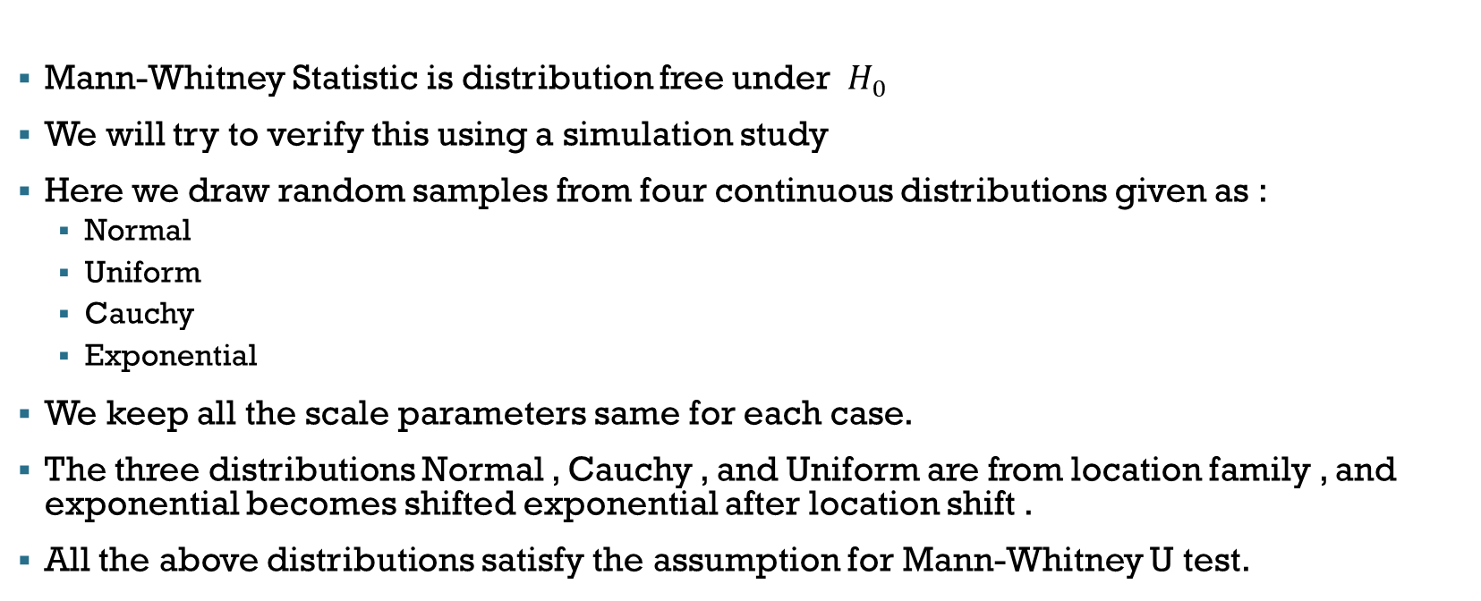
Distribution free :
Mann-Whitney Statistic is distribution free under $H_{0}$
We will try to verify this using a simulation study
Here we draw random samples from four continuous distributions given as :
Normal
Uniform
Cauchy
Exponential
We keep all the scale parameters same for each case.
The three distributions Normal , Cauchy , and Uniform are from location family , and exponential becomes shifted exponential after location shift .
All the above distributions satisfy the assumption for Mann-Whitney U test.

Slide 8
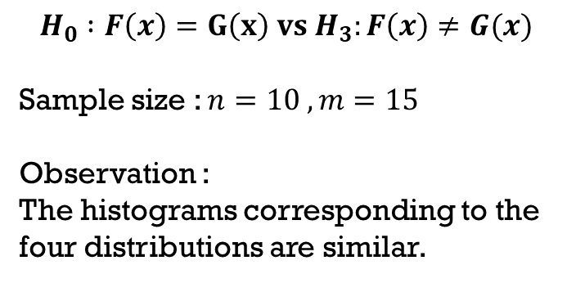
$$H_{0} :F\left(x\right)=G\left(x\right) vs H_{3}:F\left(x\right)≠G(x)$$
Sample size : $n=10 , m=15$
Observation :
The histograms corresponding to the four distributions are similar.

Slide 9
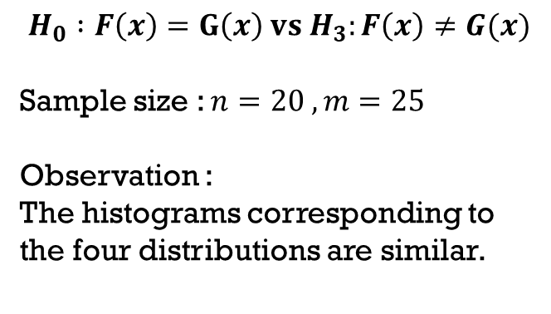
$$H_{0} :F\left(x\right)=G\left(x\right) vs H_{3}:F\left(x\right)≠G(x)$$
Sample size : $n=20 , m=25$
Observation :
The histograms corresponding to the four distributions are similar.

Slide 10
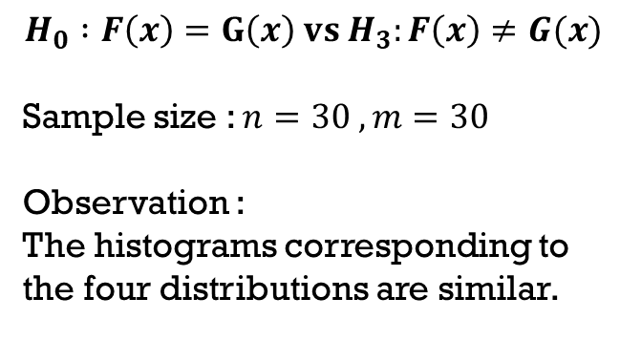
$$H_{0} :F\left(x\right)=G\left(x\right) vs{ H}_{3}:F\left(x\right)≠G(x)$$
Sample size : $n=30 , m=30$
Observation :
The histograms corresponding to the four distributions are similar.

Slide 11
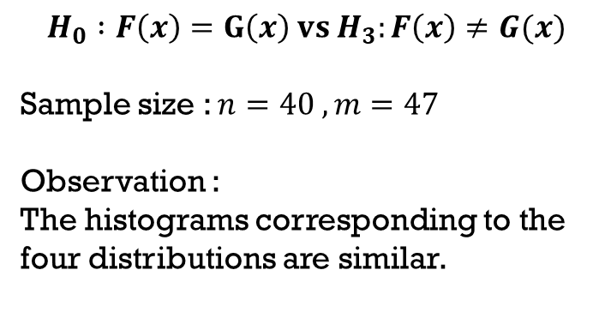
$$H_{0} :F\left(x\right)=G\left(x\right) vs{ H}_{3}:F\left(x\right)≠G(x)$$
Sample size : $n=40 , m=47$
Observation :
The histograms corresponding to the four distributions are similar.

Slide 12
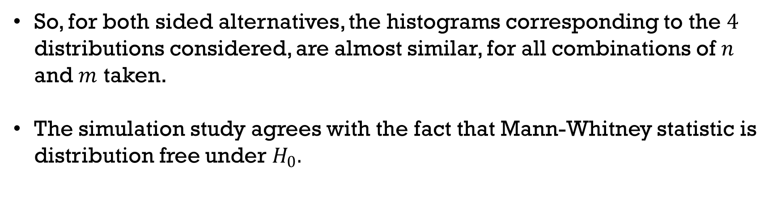
So, for both sided alternatives, the histograms corresponding to the $4$ distributions considered, are almost similar, for all combinations of $n$ and $m$ taken.
The simulation study agrees with the fact that Mann-Whitney statistic is distribution free under $H_{0}.$

Slide 13
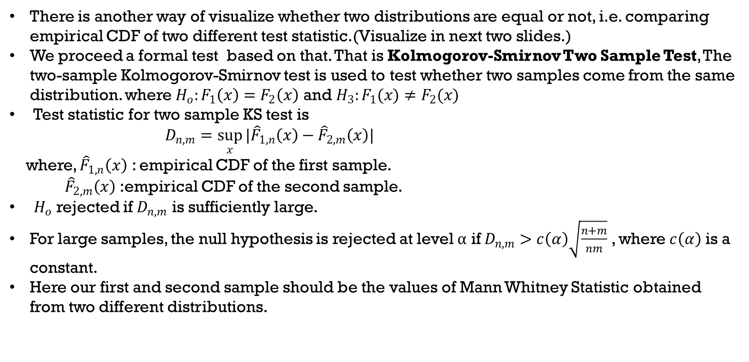
ANOTHER WAY OF VISUALIZATION OF DISTRIBUTION FREE CHARACTERISTIC
There is another way of visualize whether two distributions are equal or not, i.e. comparing empirical CDF of two different test statistic.(Visualize in next two slides.)
We proceed a formal test based on that. That is Kolmogorov-Smirnov Two Sample Test, The two-sample Kolmogorov-Smirnov test is used to test whether two samples come from the same distribution. where $H_{o}:F_{1}\left(x\right)=F_{2}\left(x\right)$ and${ H}_{3}:F_{1}(x)≠F_{2}(x)$
Test statistic for two sample KS test is
$D_{n,m}=\sup_{x}{|{\hat{F}}_{1,n}\left(x\right)−{\hat{F}}_{2,m}\left(x\right)|}$
where, ${\hat{F}}_{1,n}\left(x\right)$ : empirical CDF of the first sample.
${ \hat{F}}_{2,m}\left(x\right)$ :empirical CDF of the second sample.
$H_{o}$ rejected if $D_{n,m}$ is sufficiently large.
For large samples, the null hypothesis is rejected at level $α$ if $D_{n,m}>c\left(α\right)\sqrt{\frac{n+m}{nm}}$ , where $c\left(α\right)$ is a constant.
Here our first and second sample should be the values of Mann Whitney Statistic obtained from two different distributions.

Slide 14
p-values for KOLMOGOROV-SMIRNOV TEST
SAMPLE SIZE | NORMAL vs UNIFORM | NORMAL vs CAUCHY | NORMAL vs EXPONENTIAL | UNIFORM vs CAUCHY | UNIFORM VS EXPONENTIAL | CAUCHY VS EXPONENTIAL
n=10 m=15 | 0.759 | 0.240 | 0.0615 | 0.199 | 0.400 | 0.828
n=20 m=25 | 0.432 | 0.828 | 0.647 | 0.400 | 0.219 | 0.954
n=30 m=30 | 0.859 | 0.536 | 0.722 | 0.988 | 0.759 | 0.887
n=40 m=47 | 0.240 | 0.465 | 0.148 | 0.465 | 0.685 | 0.954

Slide 15
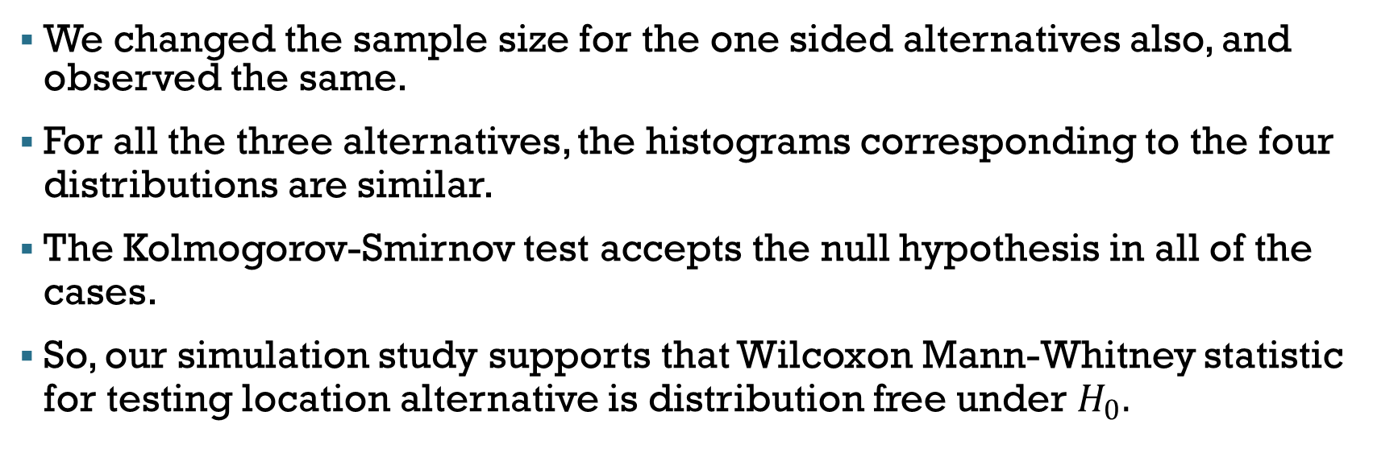
Observations :
We changed the sample size for the one sided alternatives also, and observed the same.
For all the three alternatives, the histograms corresponding to the four distributions are similar.
The Kolmogorov-Smirnov test accepts the null hypothesis in all of the cases.
So, our simulation study supports that Wilcoxon Mann-Whitney statistic for testing location alternative is distribution free under $H_{0}.$

Slide 16
PARAMETRIC COUNTERPART

Slide 17

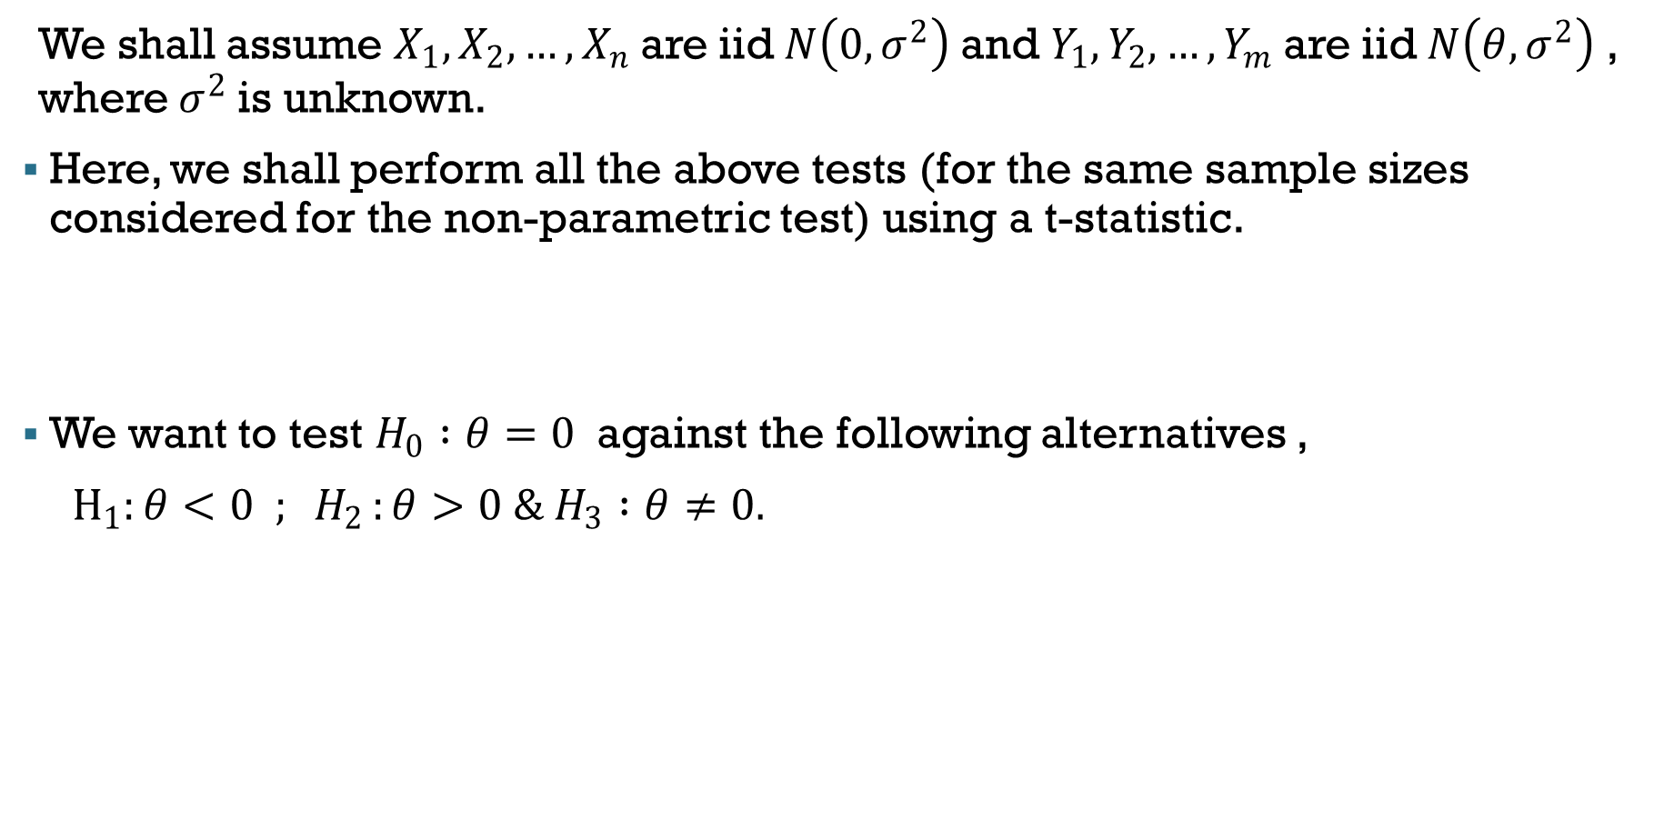
PARAMETRIC COUNTERPART :
We shall assume $X_{1},X_{2},…,X_{n}$are iid$N\left(0,σ^{2}\right)$and $Y_{1},Y_{2},…,Y_{m}$are iid$N\left(θ,σ^{2}\right)$ , where $σ^{2}$is unknown.
Here, we shall perform all the above tests (for the same sample sizes considered for the non-parametric test) using a t-statistic.
We want to test $H_{0} :θ=0$ against the following alternatives ,
$H_{1}:θ<0 ; H_{2 }:θ>0 \& H_{3} :θ≠0.$

Slide 18
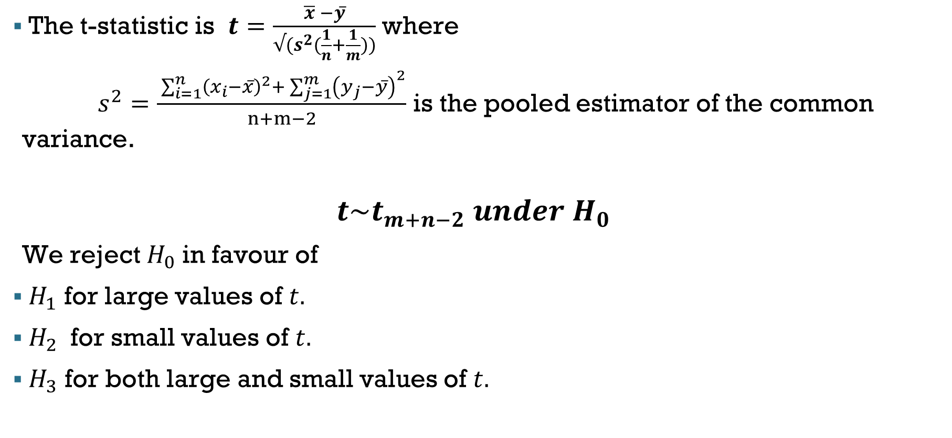
The t-statistic is $t=\frac{\overline{x} −y̅}{√(s^{2}(\frac{1}{n}+\frac{1}{m}))}$ where
$s^{2}=\frac{ \sum_{i=1}^{n}{{\left(x_{i}−x̅\right)}^{2}+ \sum_{j=1}^{m}{{\left(y_{j}−y̅\right)}^{2}}}}{n+m−2}$ is the pooled estimator of the common variance.
$$t\sim t_{m+n−2} under H_{0}$$
We reject $H_{0}$in favour of
$H_{1}$ for large values of $t.$
$H_{2}$ for small values of $t.$
$H_{3}$ for both large and small values of $t.$

Slide 19
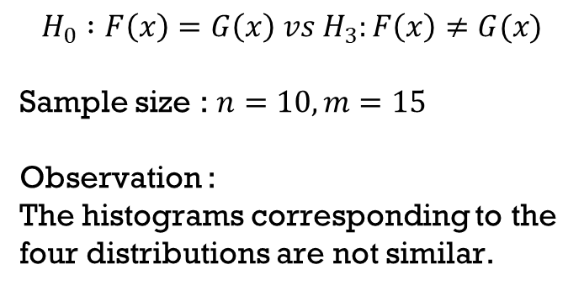
$$H_{0} :F\left(x\right)=G\left(x\right) vs{ H}_{3}:F\left(x\right)≠G(x)$$
Sample size : $n=10, m=15$
Observation :
The histograms corresponding to the four distributions are not similar.

Slide 20
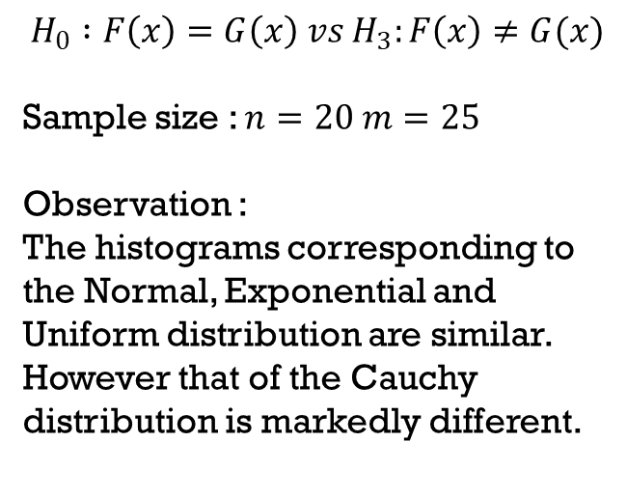
$$H_{0} :F\left(x\right)=G\left(x\right) vs{ H}_{3}:F\left(x\right)≠G(x)$$
Sample size : $n=20 m=25$
Observation :
The histograms corresponding to the Normal, Exponential and Uniform distribution are similar. However that of the Cauchy distribution is markedly different.

Slide 21
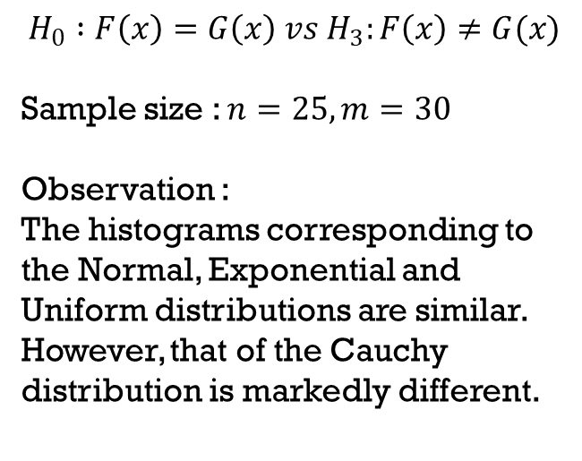
$$H_{0} :F\left(x\right)=G\left(x\right) vs{ H}_{3}:F\left(x\right)≠G(x)$$
Sample size : $n=25, m=30$
Observation :
The histograms corresponding to the Normal, Exponential and Uniform distributions are similar. However, that of the Cauchy distribution is markedly different.

Slide 22
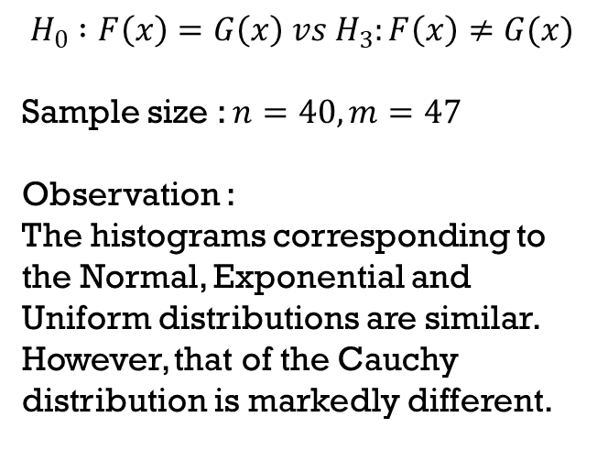
$$H_{0} :F\left(x\right)=G\left(x\right) vs{ H}_{3}:F\left(x\right)≠G(x)$$
Sample size : $n=40, m=47$
Observation :
The histograms corresponding to the Normal, Exponential and Uniform distributions are similar. However, that of the Cauchy distribution is markedly different.

Slide 23
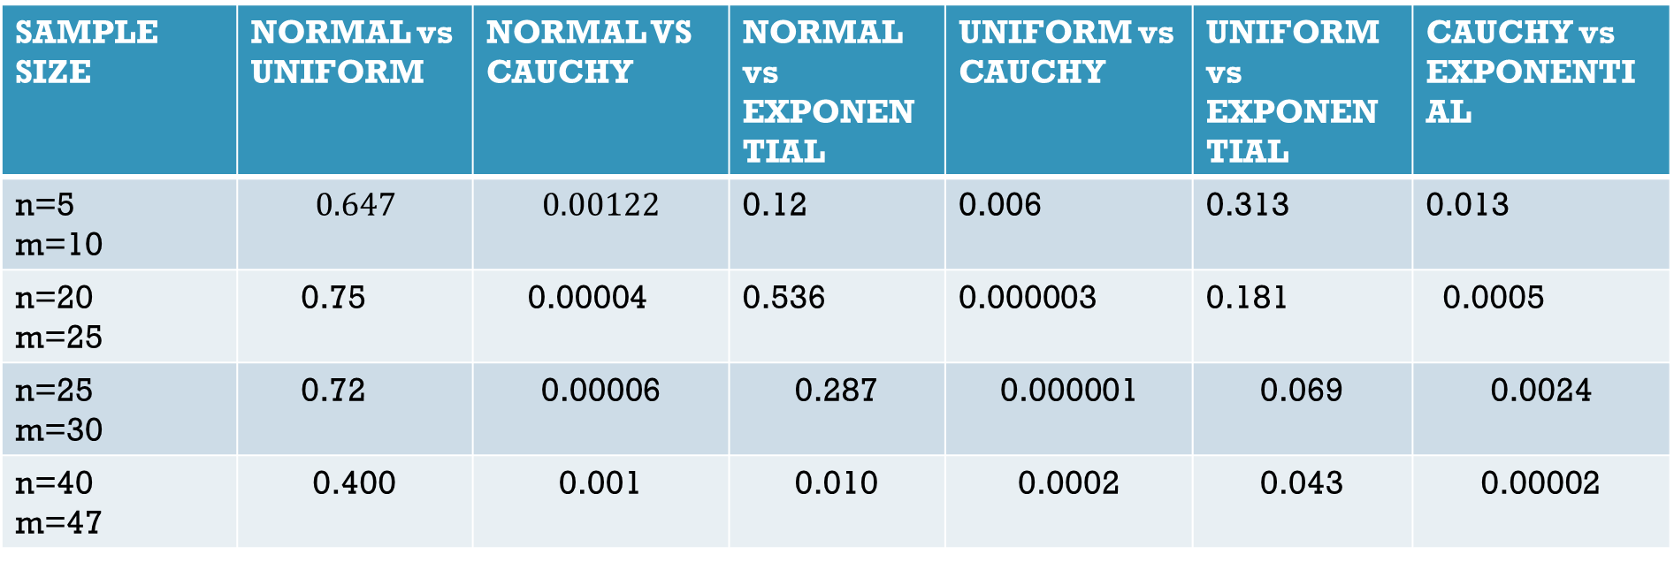
p-values for KOLMOGORV-SMIRNOV TEST
0.78
00.56

Slide 24
Observation :
The distribution of the statistic obtained from the Cauchy distribution does not agree with the distribution of the statistic obtained from any other distribution.
For the other pairs of distribution Kolgomorov-Smirnov test accepts the null for all cases.
This clearly denotes that the parametric test does not satisfy the distribution free property.

Slide 25
Limiting Distribution

Slide 26
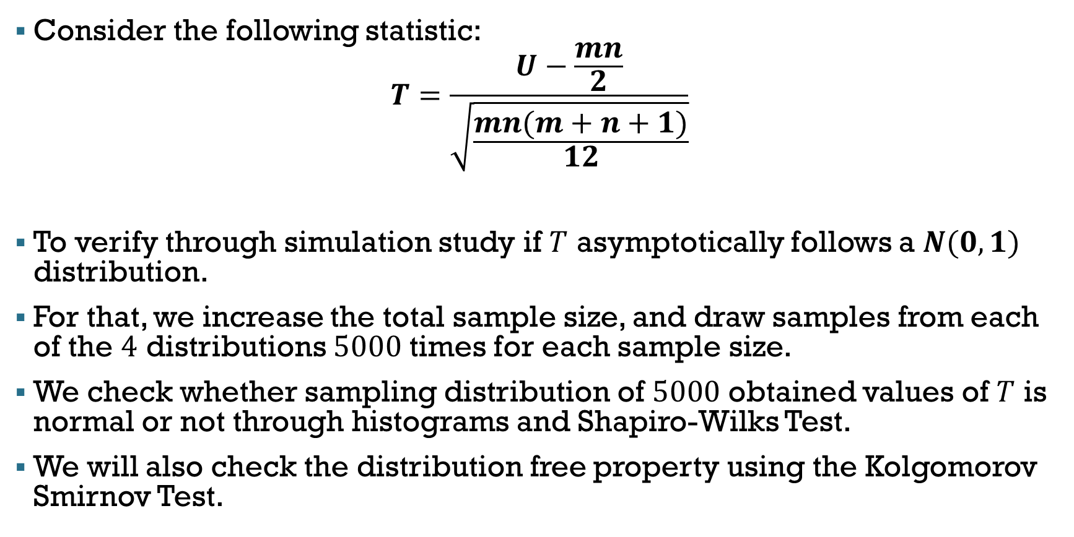
Non-Parametric Test
Consider the following statistic:
$$T=\frac{U−\frac{mn}{2}}{\sqrt{\frac{mn(m+n+1)}{12}}}$$
To verify through simulation study if $T$ asymptotically follows a $N(0,1)$ distribution.
For that, we increase the total sample size, and draw samples from each of the $4$ distributions $5000$ times for each sample size.
We check whether sampling distribution of $5000$ obtained values of $T$ is normal or not through histograms and Shapiro-Wilks Test.
We will also check the distribution free property using the Kolgomorov Smirnov Test.

Slide 27
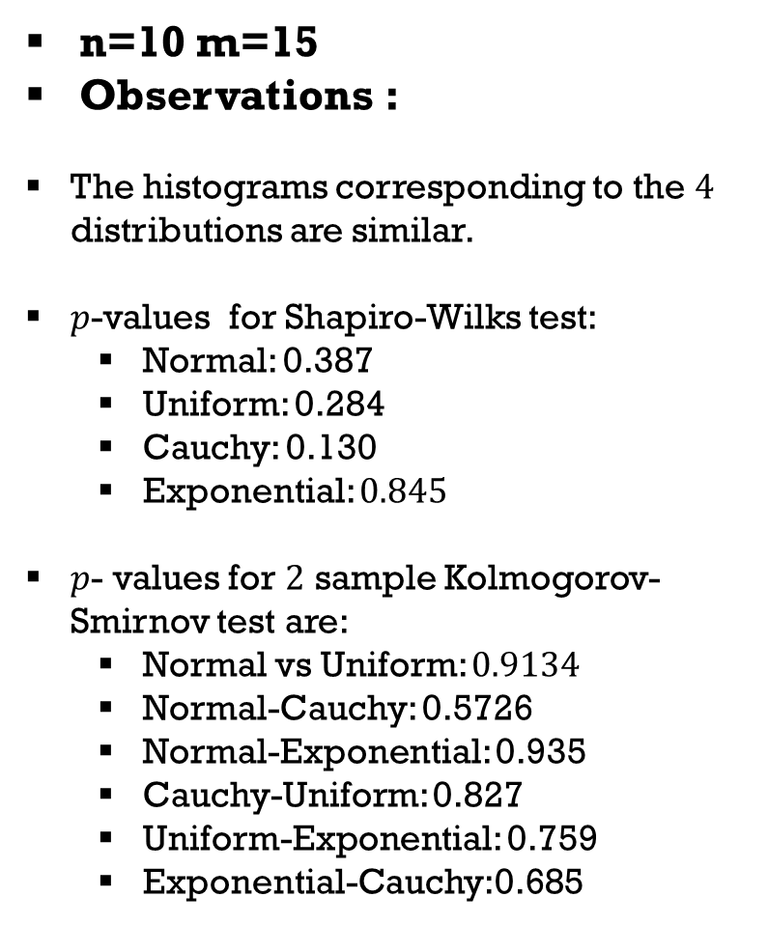
n=10 m=15
Observations :
The histograms corresponding to the $4$ distributions are similar.
$p$-values for Shapiro-Wilks test:
Normal: 0.387
Uniform: 0.284
Cauchy: 0.130
Exponential: $0.845$
$p$- values for $2$ sample Kolmogorov-Smirnov test are:
Normal vs Uniform: $0.9134$
Normal-Cauchy: 0.5726
Normal-Exponential: 0.935
Cauchy-Uniform: 0.827
Uniform-Exponential: 0.759
Exponential-Cauchy:0.685

Slide 28
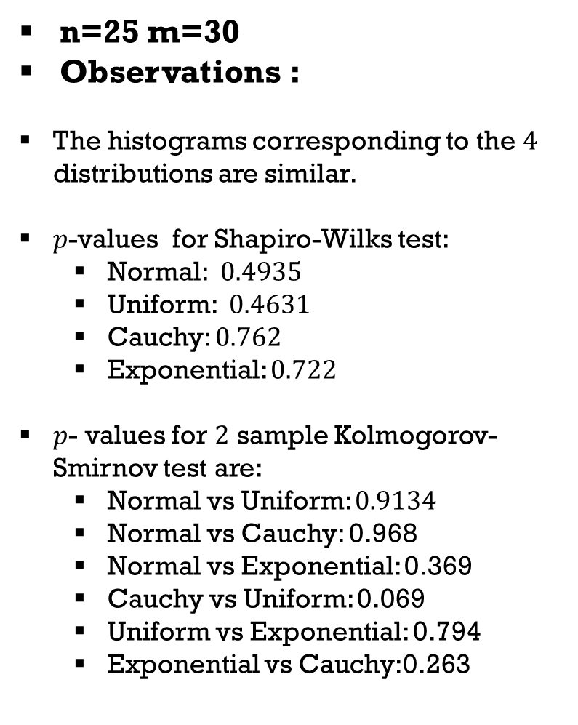
n=25 m=30
Observations :
The histograms corresponding to the $4$ distributions are similar.
$p$-values for Shapiro-Wilks test:
Normal: $0.4935$
Uniform: $0.4631$
Cauchy: $0.762$
Exponential: $0.722$
$p$- values for $2$ sample Kolmogorov-Smirnov test are:
Normal vs Uniform: $0.9134$
Normal vs Cauchy: 0.968
Normal vs Exponential: 0.369
Cauchy vs Uniform: 0.069
Uniform vs Exponential: 0.794
Exponential vs Cauchy:0.263

Slide 29
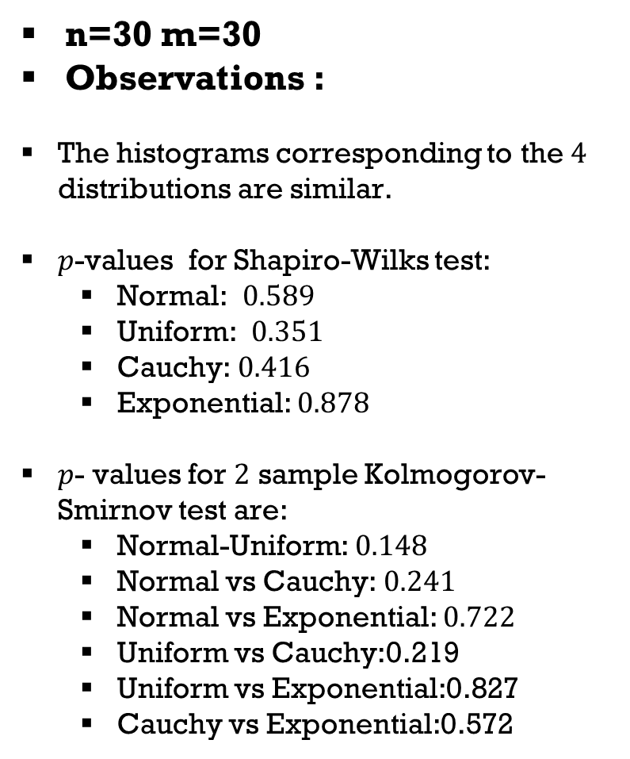
n=30 m=30
Observations :
The histograms corresponding to the $4$ distributions are similar.
$p$-values for Shapiro-Wilks test:
Normal: $0.589$
Uniform: $0.351$
Cauchy: $0.416$
Exponential: $0.878$
$p$- values for $2$ sample Kolmogorov-Smirnov test are:
Normal-Uniform: $0.148$
Normal vs Cauchy: $0.241$
Normal vs Exponential: $0.722$
Uniform vs Cauchy:0.219
Uniform vs Exponential:0.827
Cauchy vs Exponential:0.572

Slide 30
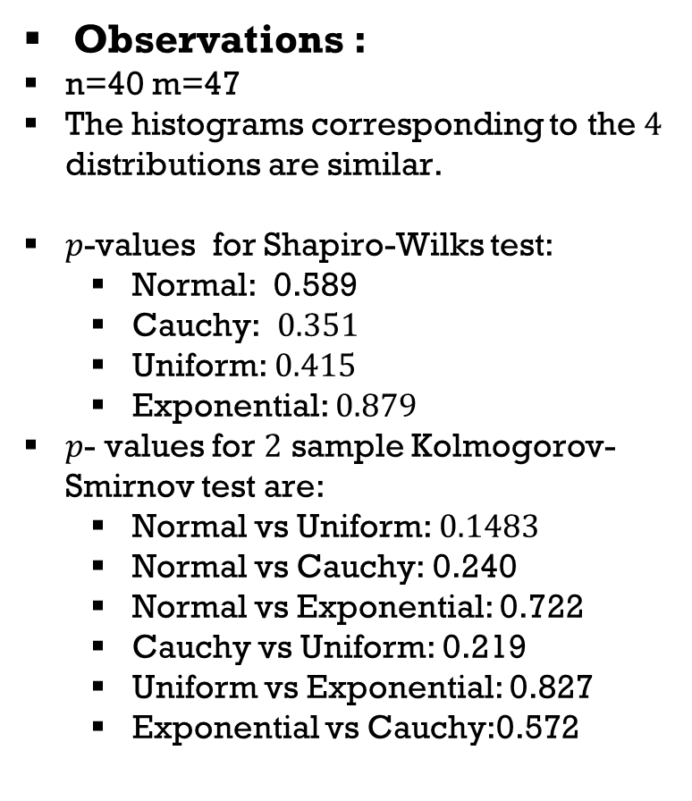
Observations :
n=40 m=47
The histograms corresponding to the $4$ distributions are similar.
$p$-values for Shapiro-Wilks test:
Normal: 0.589
Cauchy: $0.351$
Uniform: $0.415$
Exponential: $0.879$
$p$- values for $2$ sample Kolmogorov-Smirnov test are:
Normal vs Uniform: $0.1483$
Normal vs Cauchy: 0.240
Normal vs Exponential: 0.722
Cauchy vs Uniform: 0.219
Uniform vs Exponential: 0.827
Exponential vs Cauchy:0.572

Slide 31
Comments:
In all the cases Shapiro Wilk test as well as Kolgomorov Smirnov test accept the null hypothesis and the histograms look similar for all 4 distributions for various choices of m and n.
So we can say the Mann Whitney Statistic is asymptotically normal and it again shows the distribution free property of the statistic for large sample sizes.

Slide 32
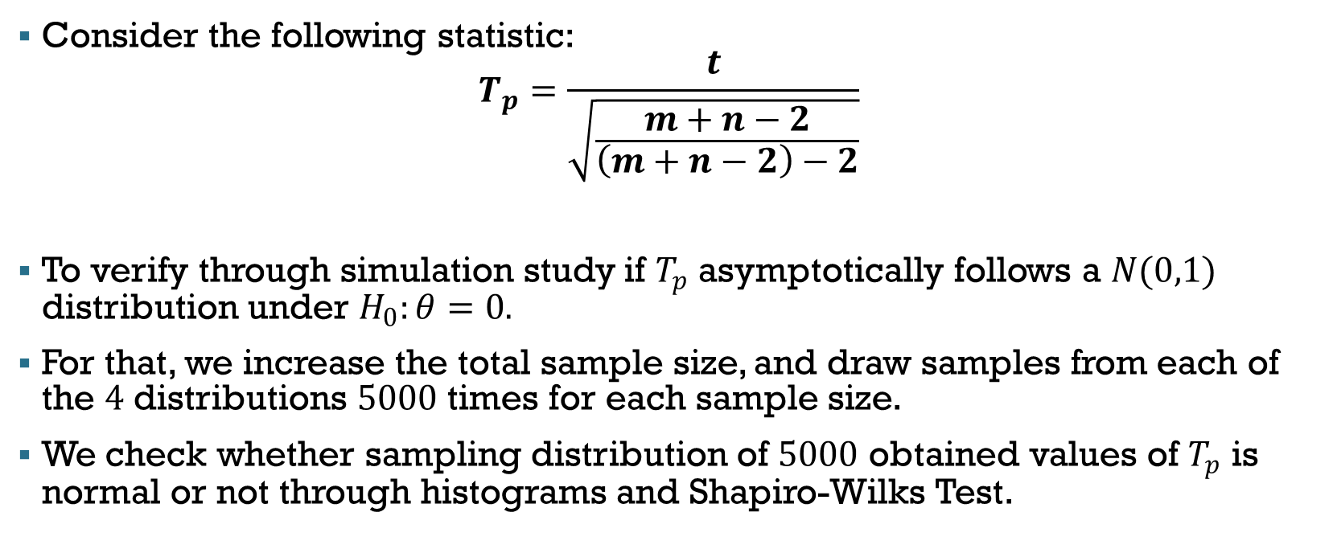
Parametric Counterpart
Consider the following statistic:
$$T_{p}=\frac{t}{\sqrt{\frac{m+n−2}{\left(m+n−2\right)−2}}}$$
To verify through simulation study if $T_{p}$ asymptotically follows a $N(0,1)$ distribution under $H_{0}:θ=0.$
For that, we increase the total sample size, and draw samples from each of the $4$ distributions $5000$ times for each sample size.
We check whether sampling distribution of $5000$ obtained values of $T_{p}$ is normal or not through histograms and Shapiro-Wilks Test.

Slide 33
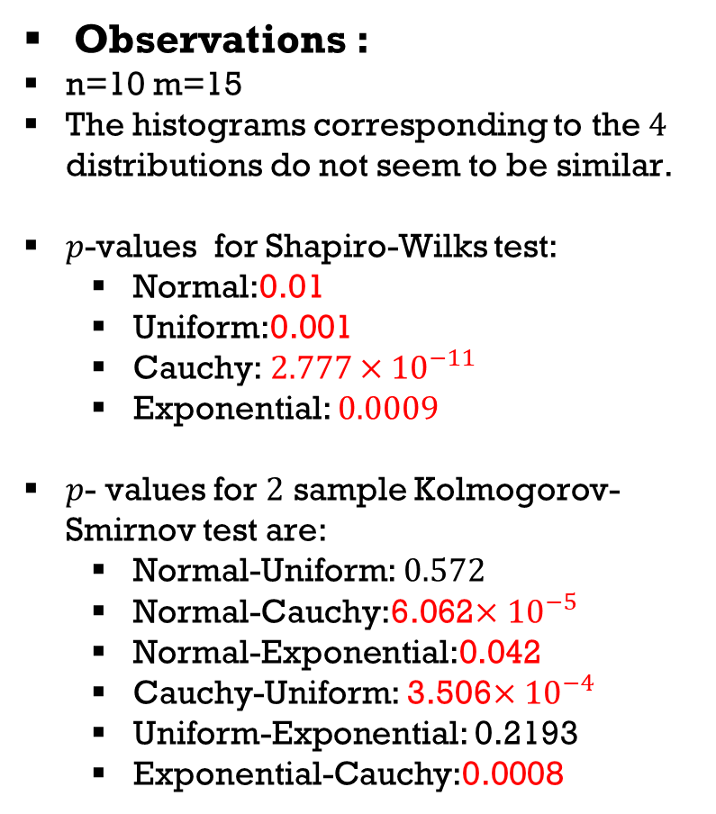
Observations :
n=10 m=15
The histograms corresponding to the $4$ distributions do not seem to be similar.
$p$-values for Shapiro-Wilks test:
Normal:0.01
Uniform:0.001
Cauchy: $2.777×{10}^{−11}$
Exponential: $0.0009$
$p$- values for $2$ sample Kolmogorov-Smirnov test are:
Normal-Uniform: $0.572$
Normal-Cauchy:6.062$×{10}^{−5}$
Normal-Exponential:0.042
Cauchy-Uniform: 3.506$×{10}^{−4}$
Uniform-Exponential: 0.2193
Exponential-Cauchy:0.0008

Slide 34
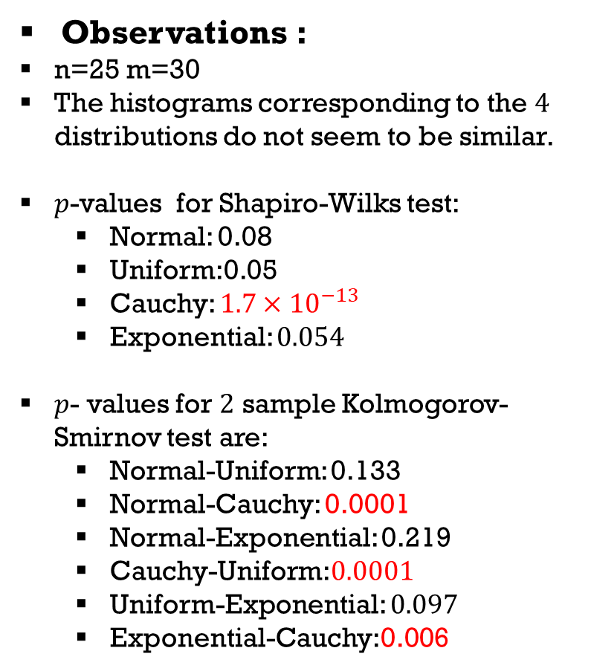
Observations :
n=25 m=30
The histograms corresponding to the $4$ distributions do not seem to be similar.
$p$-values for Shapiro-Wilks test:
Normal: 0.08
Uniform:0.05
Cauchy: $1.7×{10}^{−13}$
Exponential: $0.054$
$p$- values for $2$ sample Kolmogorov-Smirnov test are:
Normal-Uniform: 0.133
Normal-Cauchy: 0.0001
Normal-Exponential: 0.219
Cauchy-Uniform:$0.0001$
Uniform-Exponential: $0.097$
Exponential-Cauchy:0.006

Slide 35
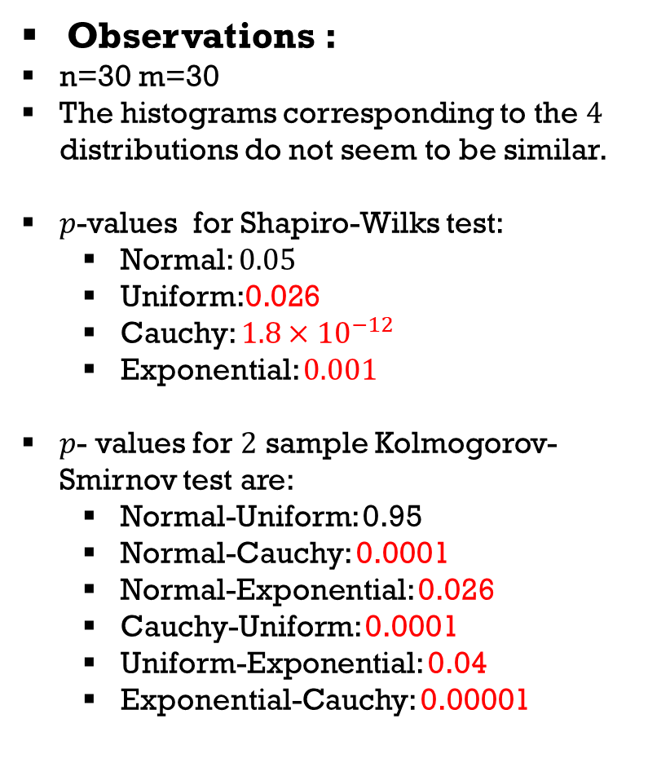
Observations :
n=30 m=30
The histograms corresponding to the $4$ distributions do not seem to be similar.
$p$-values for Shapiro-Wilks test:
Normal: $0.05$
Uniform:0.026
Cauchy: $1.8×{10}^{−12}$
Exponential: $0.001$
$p$- values for $2$ sample Kolmogorov-Smirnov test are:
Normal-Uniform: 0.95
Normal-Cauchy: 0.0001
Normal-Exponential: 0.026
Cauchy-Uniform: 0.0001
Uniform-Exponential: 0.04
Exponential-Cauchy: 0.00001

Slide 36
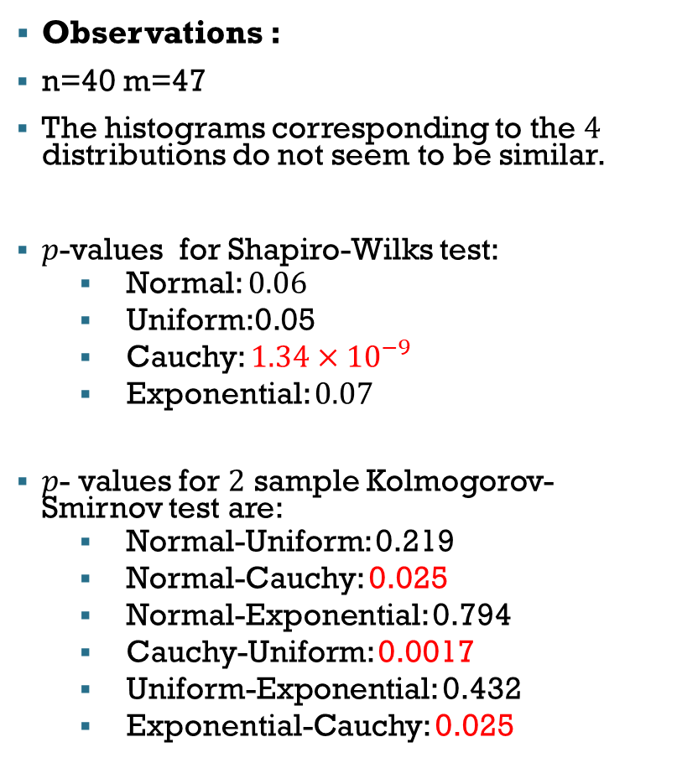
Observations :
n=40 m=47
The histograms corresponding to the $4$ distributions do not seem to be similar.
$p$-values for Shapiro-Wilks test:
Normal: $0.06$
Uniform:0.05
Cauchy: $1.34×{10}^{−9}$
Exponential: $0.07$
$p$- values for $2$ sample Kolmogorov-Smirnov test are:
Normal-Uniform: 0.219
Normal-Cauchy: 0.025
Normal-Exponential: 0.794
Cauchy-Uniform: 0.0017
Uniform-Exponential: 0.432
Exponential-Cauchy: 0.025

Slide 37
Comments:
In this case also the statistic obtained from Cauchy distribution does not agree with the same obtained from other three distributions for large sample sizes and it does not follow the normal distribution asymptotically.
For other three distribution Shapiro wilk test as well as Kolgomorov Smirnov Test accepts the null hypothesis for large values of sample size. So the statistic is asymptotically normal for these three distribution.
It again shows that parametric test does not agree with distribution free property of the test statistic even if for large sample sizes.

Slide 38
SIZE OF THE TEST

Slide 39
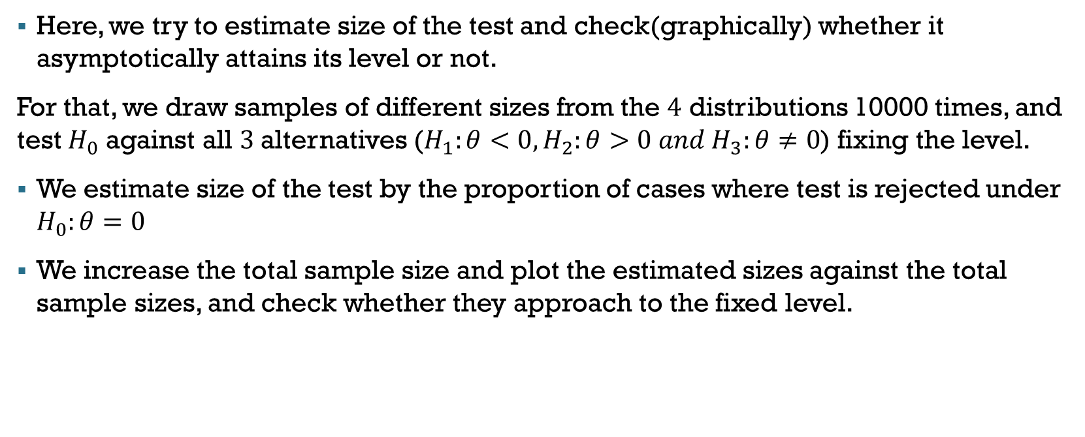
Size of Test for Non Parametric Exact Distribution :
Here, we try to estimate size of the test and check(graphically) whether it asymptotically attains its level or not.
For that, we draw samples of different sizes from the $4$ distributions 10000 times, and test $H_{0}$ against all $3$alternatives ($H_{1}:θ<0,H_{2}:θ>0 and H_{3}:θ≠0$) fixing the level.
We estimate size of the test by the proportion of cases where test is rejected under $H_{0}:θ=0$
We increase the total sample size and plot the estimated sizes against the total sample sizes, and check whether they approach to the fixed level.

Slide 40

$$H_{1}:θ<0$$

Slide 41
$$H_{1}:θ<0$$

Slide 42
$$H_{1}:θ<0$$

Slide 43



$$α=0.001$$
$$α=0.005$$
$$H_{2}:θ>0$$

Slide 44


$$α=0.01$$
$$α=0.05$$
$$H_{2}:θ>0$$

Slide 45


$$α=0.1$$
$$α=0.4$$
$$H_{2}:θ>0$$

Slide 46



$$α=0.001$$
$$α=0.005$$
$$H_{3}:θ≠0$$

Slide 47


$$α=0.01$$
$$α=0.05$$
$$H_{3}:θ≠0$$

Slide 48



$$α=0.1$$
$$α=0.4$$
$$H_{3}:θ≠0$$
In most of the cases, as the total sample size increases, the estimate of size of the test gets close to actual level .

Slide 49
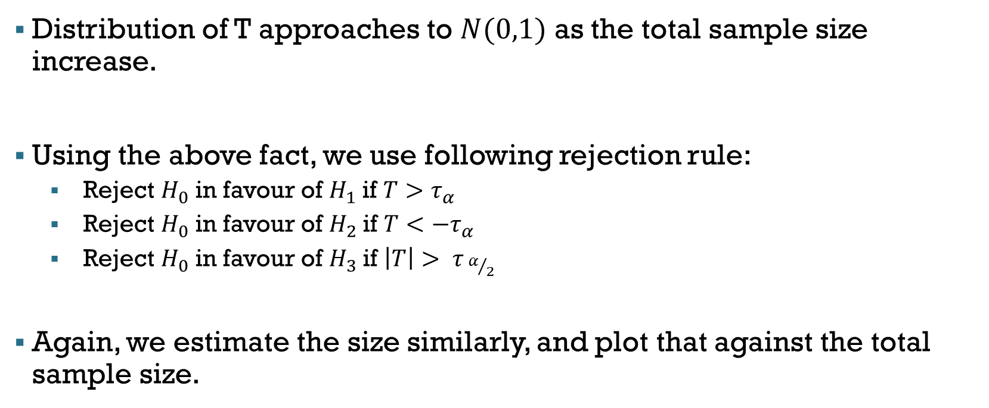
Size Of Test for Non Parametric Asymptotic Distribution :
Distribution of T approaches to $N(0,1)$ as the total sample size increase.
Using the above fact, we use following rejection rule:
Reject $H_{0}$ in favour of $H_{1}$ if $T>τ_{α}$
Reject $H_{0}$ in favour of $H_{2}$ if $T<−τ_{α}$
Reject $H_{0}$ in favour of $H_{3}$ if $\left|T\right|> τ_{ α/2}$
Again, we estimate the size similarly, and plot that against the total sample size.

Slide 50



$$α=0.001$$
$$H_{1}:θ<0$$
$$α=0.005$$

Slide 51


$$α=0.01$$
$$α=0.05$$
$$H_{1}:θ<0$$

Slide 52


$$α=0.1$$
$$α=0.4$$
$$H_{1}:θ<0$$

Slide 53
$$α=0.001$$
$$H_{2}:θ>0$$
$$α=0.005$$

Slide 54
$$α=0.01$$
$$α=0.05$$
$$H_{2}:θ>0$$

Slide 55


$$α=0.1$$
$$α=0.4$$
$$H_{2}:θ>0$$

Slide 56
$$H_{3}:θ≠0$$
$$α=0.001$$
$$α=0.005$$

Slide 57
$$α=0.01$$
$$α=0.05$$
$$H_{3}:θ≠0$$

Slide 58


$$α=0.1$$
$$α=0.4$$
$$H_{3}:θ≠0$$
Here also, we can see that, the estimate of size goes closer to the defined level as the total sample size increases.

Slide 59
Size of Test for Parametric Exact Distribution :

Slide 60

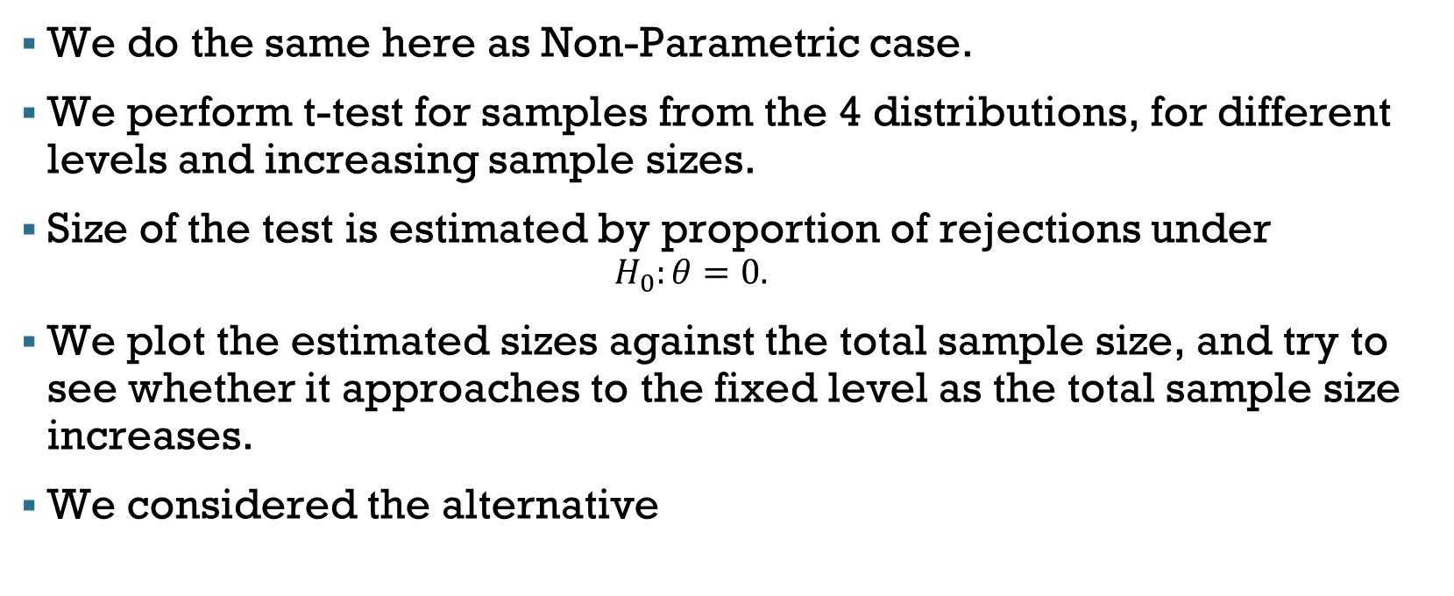
Parametric Counterpart
We do the same here as Non-Parametric case.
We perform t-test for samples from the 4 distributions, for different levels and increasing sample sizes.
Size of the test is estimated by proportion of rejections under
$$H_{0}:θ=0.$$
We plot the estimated sizes against the total sample size, and try to see whether it approaches to the fixed level as the total sample size increases.
We considered the alternative
$$H_{1}:θ<0$$

Slide 61
In both cases, for samples from normal, uniform and exponential distribution, the estimate of size goes closer to the actual level as total sample size increases and for samples from Cauchy distribution, the estimate does not at all go closer to the actual level.

Slide 62
Here also, we can see that in case of samples from Cauchy distribution, the estimate of size stays far away from the actual level even if we increase the total sample size and in rest of the cases, the estimate goes close to the actual level.

Slide 63
For samples from all $4$ distributions except for Cauchy, the estimate of size goes close to the actual level of the test as the total sample size increases.

Slide 64

Here also, we can observe that in case of samples arising out of normal, uniform and exponential distribution, the estimate of size gets close to the actual level as the total sample size increases, but for samples from Cauchy distribution, the estimate of size is always much more higher than actual level of the test.
Above observation supports the fact that the statistic is not distribution free.
The statistic performs perfectly when the sample arises out of a normal distribution.
We observe that, for samples from uniform and exponential distribution also, the estimate of size gets closer to actual level as the total sample size increases.
But, for sample from Cauchy distribution, the estimated size does not at all go close to the actual level of the test, so the distribution of the statistic deviates from normality very highly.
$$α=0.3$$

Slide 65
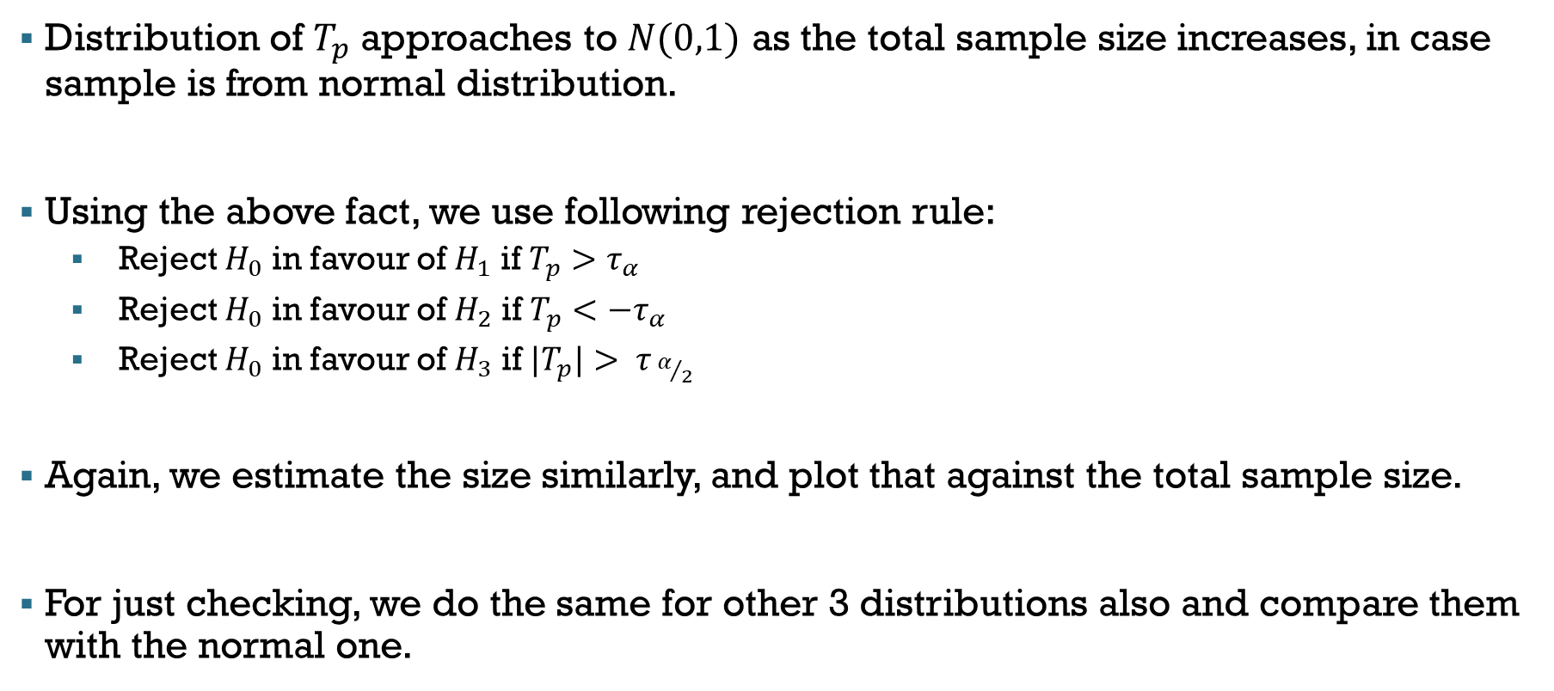
Size of Test using Asymptotic Distribution
Distribution of $T_{p}$ approaches to $N(0,1)$ as the total sample size increases, in case sample is from normal distribution.
Using the above fact, we use following rejection rule:
Reject $H_{0}$ in favour of $H_{1}$ if $T_{p}>τ_{α}$
Reject $H_{0}$ in favour of $H_{2}$ if $T_{p}<−τ_{α}$
Reject $H_{0}$ in favour of $H_{3}$ if${ |T}_{p}|> τ_{ α/2}$
Again, we estimate the size similarly, and plot that against the total sample size.
For just checking, we do the same for other 3 distributions also and compare them with the normal one.

Slide 66
We can observe that in case of samples arising out of normal, uniform and exponential distribution, the estimate of size gets close to the actual level as the total sample size increases, but for samples from Cauchy distribution, the estimate of size is usually less than the actual level.

Slide 67
Here also, we can see that for samples from normal, uniform and exponential distribution, the estimate of size gets close to the actual level as total sample size increases, but for samples from Cauchy distribution, the estimate of size is much less than the actual level, even if the sample size is increased.

Slide 68
We can observe that, for samples from all $4$ distributions except for the Cauchy one, the estimate of size goes close to the actual level of the test as the total sample size increases.

Slide 69
Here also, we can observe that in case of samples arising out of normal, uniform and exponential distribution, the estimate of size gets close to the actual level as the total sample size increases, but for samples from Cauchy distribution, the estimate of size always stays away from actual level of the test, even if the sample size increases.
Above observation supports the fact that the standardised form of the statistic is also not distribution free.
We observe that, for samples from normal, uniform and exponential distribution also, the estimate of size gets closer to actual level as the total sample size increases, i.e., in these cases, the standardised statistic is approximately normal.
But, for sample from Cauchy distribution, the estimated size does not at all go close to the actual level of the test, so the distribution of the standardised statistic deviates from normality very highly.

Slide 70
POWER FUNCTION

Slide 71
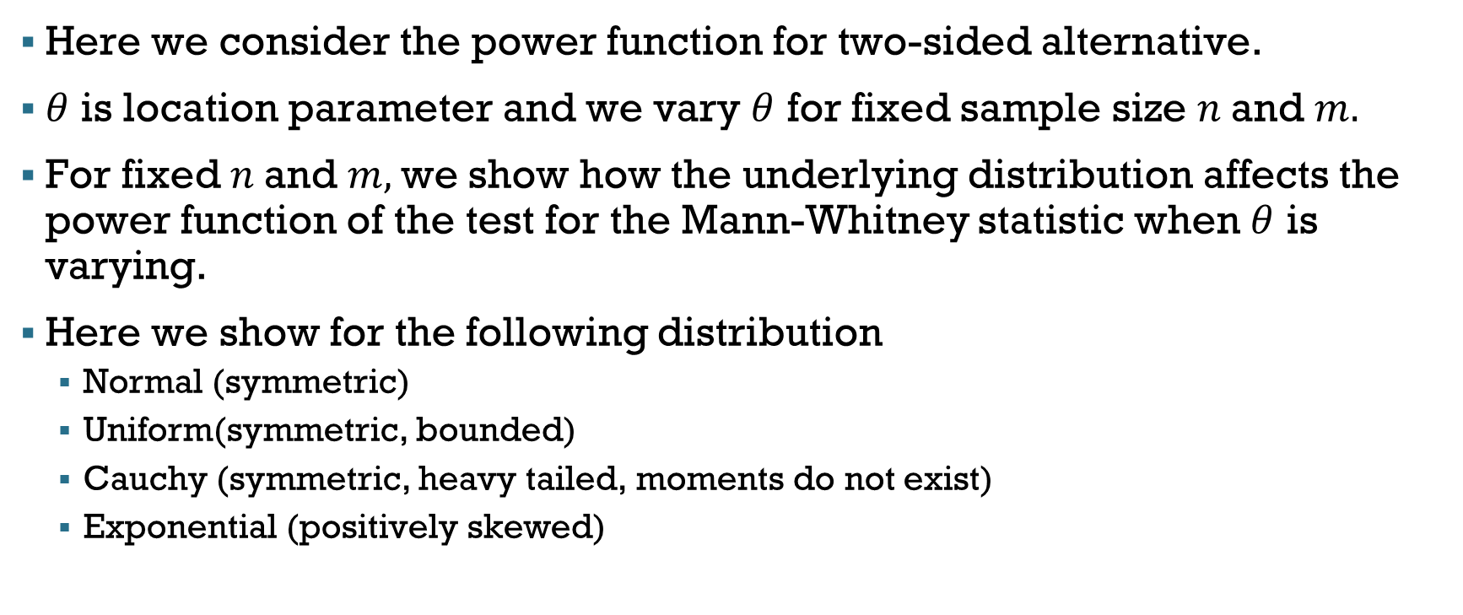

POWER FUNCTION ($β_{n,m}(θ)$)
Here we consider the power function for two-sided alternative.
$θ$ is location parameter and we vary $θ$ for fixed sample size $n$and $m.$
For fixed $n$and $m,$we show how the underlying distribution affects the power function of the test for the Mann-Whitney statistic when $θ$ is varying.
Here we show for the following distribution
Normal (symmetric)
Uniform(symmetric, bounded)
Cauchy (symmetric, heavy tailed, moments do not exist)
Exponential (positively skewed)

Slide 72
Here we plot the power function of the Mann-Whitney Statistic against different values of the location parameter, where sample size is fixed.
Observations:
Uniform has more power than the other three distributions.
Normal has less power than exponential but for higher values of the parameter power plot moderately coincide with the exponential one.
Cauchy has the least power among the four distribution under consideration.

Slide 73
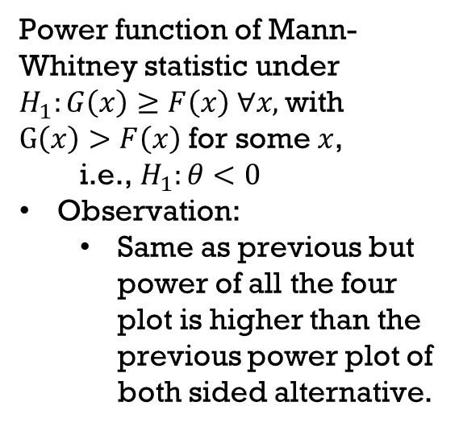
Power function of Mann-Whitney statistic under $H_{1}:G\left(x\right)≥F\left(x\right) ∀x,$with $G\left(x\right)>F\left(x\right)$ for some $x$, i.e., $H_{1}:θ<0$
Observation:
Same as previous but power of all the four plot is higher than the previous power plot of both sided alternative.

Slide 74
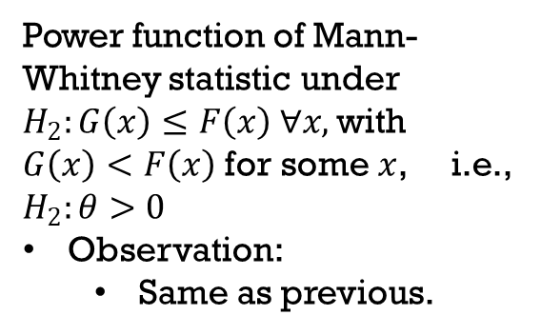
Power function of Mann-Whitney statistic under $H_{2}:G\left(x\right)≤F\left(x\right) ∀x,$with $G\left(x\right)<F\left(x\right)$ for some $x$, i.e., $H_{2}:θ>0$
Observation:
Same as previous.

Slide 75
Here we plot the power function of Mann-Whitney Statistic and corresponding t-statistic
Observation:
Power function of the t-statistic is slightly higher than Mann-Whitney statistic.
Here we have performed t-test, which is the MP test when sample actually comes from normal. So, parametric counter part has higher power as expected.

Slide 77
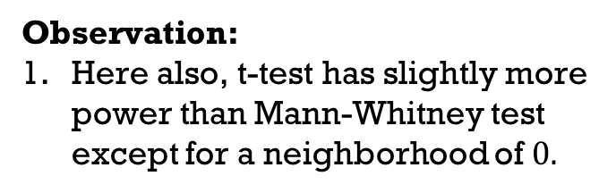
Observation:
Here also, t-test has slightly more power than Mann-Whitney test except for a neighborhood of $0.$

Slide 78
Observation:
Samples come from Cauchy population but we have used the t-statistic which makes normal assumption. So, the power is less.
Since Mann-Whitney statistic does not require any distributional assumption, here power is more than t-test.

Slide 79
Observation:
We have used the t-statistic assuming the sample to be normal, but samples come from exponential population. So, the power gets decreased but not like Cauchy distribution.
Since Mann-Whitney statistic does not require any distributional assumption, here power is moderately higher than t-test.

Slide 80
ASYMPTOTIC BEHAVIOUR OF POWER FUNCTION

Slide 81
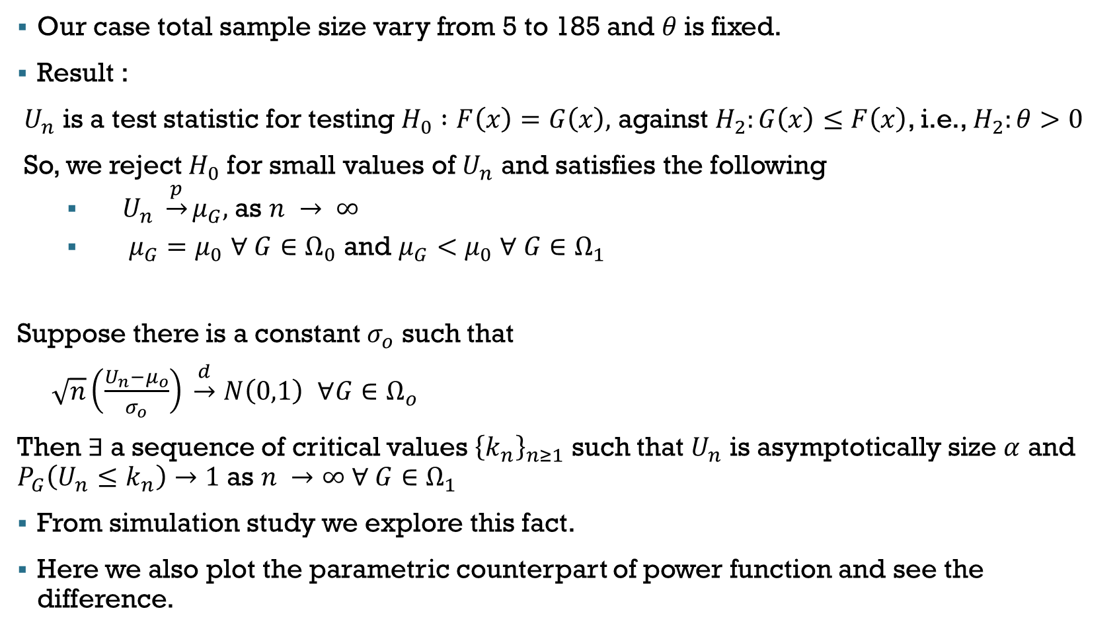
Consistency of test :
Our case total sample size vary from 5 to 185 and $θ$is fixed.
Result :
$U_{n}$ is a test statistic for testing $H_{0} :F\left(x\right)=G\left(x\right),$ against $H_{2}:G\left(x\right)≤F\left(x\right)$, i.e., $H_{2}:θ>0$
So, we reject $H_{0}$ for small values of $U_{n}$ and satisfies the following
$U_{n} \underset{→}{p}μ_{G},$as $n → ∞$
$μ_{G}=μ_{0}$ $∀ G∈Ω_{0}$ and $μ_{G}<μ_{0}$ $∀ G∈Ω_{1}$
Suppose there is a constant $σ_{o}$ such that
$\sqrt{n}\left(\frac{U_{n}−μ_{o}}{σ_{o}}\right) \underset{→}{d}$ $N\left(0,1\right)$ $∀G∈Ω_{o}$
Then $∃$a sequence of critical values ${\left\{k_{n}\right\}}_{n≥1}$ such that $U_{n}$ is asymptotically size $α$ and $P_{G}\left(U_{n}≤k_{n}\right)→1$as $n →∞ ∀ G∈Ω_{1}$
From simulation study we explore this fact.
Here we also plot the parametric counterpart of power function and see the difference.

Slide 82

$$θ=1$$

Slide 83
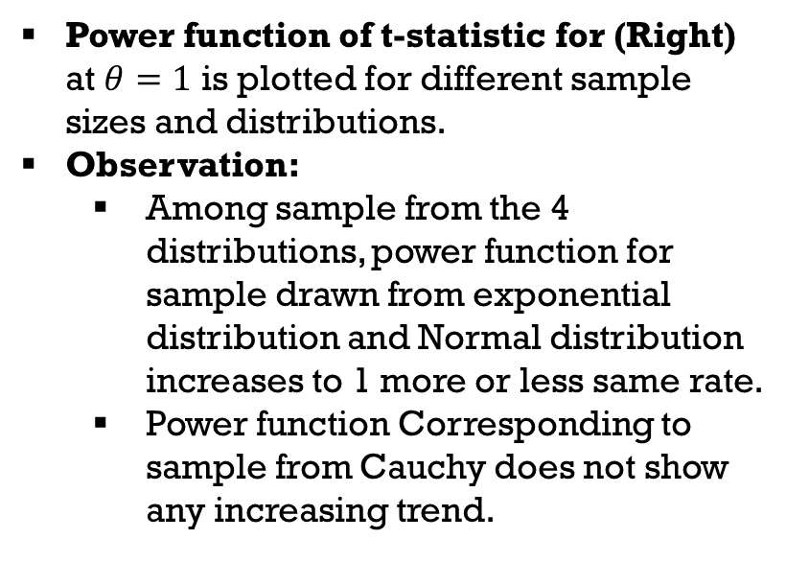
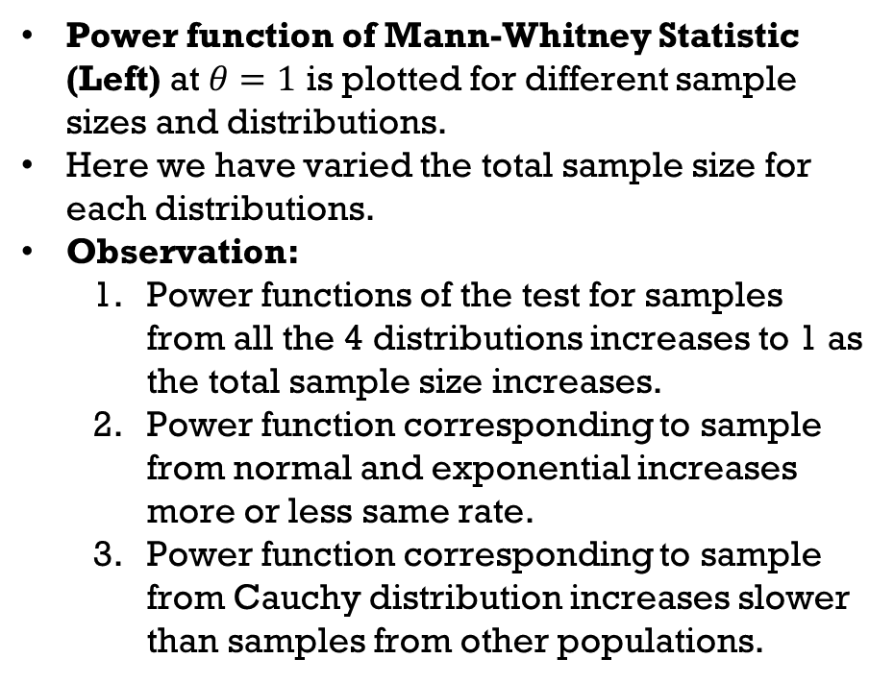
Power function of Mann-Whitney Statistic (Left) at $θ=1$ is plotted for different sample sizes and distributions.
Here we have varied the total sample size for each distributions.
Observation:
Power functions of the test for samples from all the 4 distributions increases to 1 as the total sample size increases.
Power function corresponding to sample from normal and exponential increases more or less same rate.
Power function corresponding to sample from Cauchy distribution increases slower than samples from other populations.
Power function of t-statistic for (Right) at $θ=1$ is plotted for different sample sizes and distributions.
Observation:
Among sample from the 4 distributions, power function for sample drawn from exponential distribution and Normal distribution increases to 1 more or less same rate.
Power function Corresponding to sample from Cauchy does not show any increasing trend.
Among samples from the 4 distributions, power function for sample drawn from uniform distribution increases to 1 for smaller sample size than samples from other populations.

Slide 84

$$θ=2$$

Slide 85

$$θ=3$$

Slide 86

$$θ=4$$

Slide 87

$$θ=5$$

Slide 88

$$θ=6$$

Slide 89

$$θ=7$$

Slide 90

$$θ=8$$

Slide 91
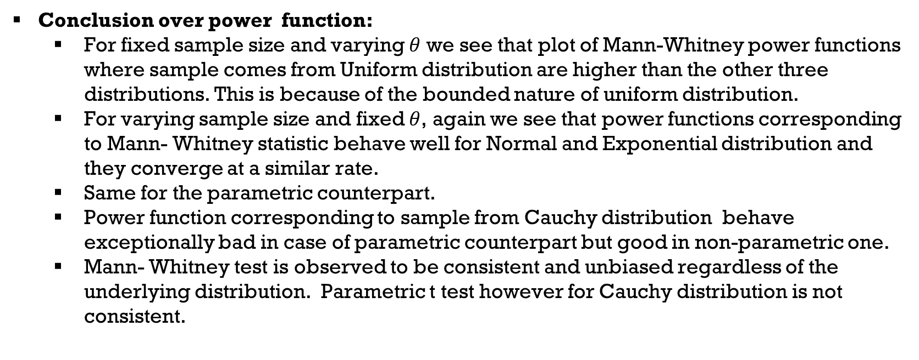
Conclusion over power function:
For fixed sample size and varying $θ$ we see that plot of Mann-Whitney power functions where sample comes from Uniform distribution are higher than the other three distributions. This is because of the bounded nature of uniform distribution.
For varying sample size and fixed $θ$, again we see that power functions corresponding to Mann- Whitney statistic behave well for Normal and Exponential distribution and they converge at a similar rate.
Same for the parametric counterpart.
Power function corresponding to sample from Cauchy distribution behave exceptionally bad in case of parametric counterpart but good in non-parametric one.
Mann- Whitney test is observed to be consistent and unbiased regardless of the underlying distribution. Parametric t test however for Cauchy distribution is not consistent.

Slide 92
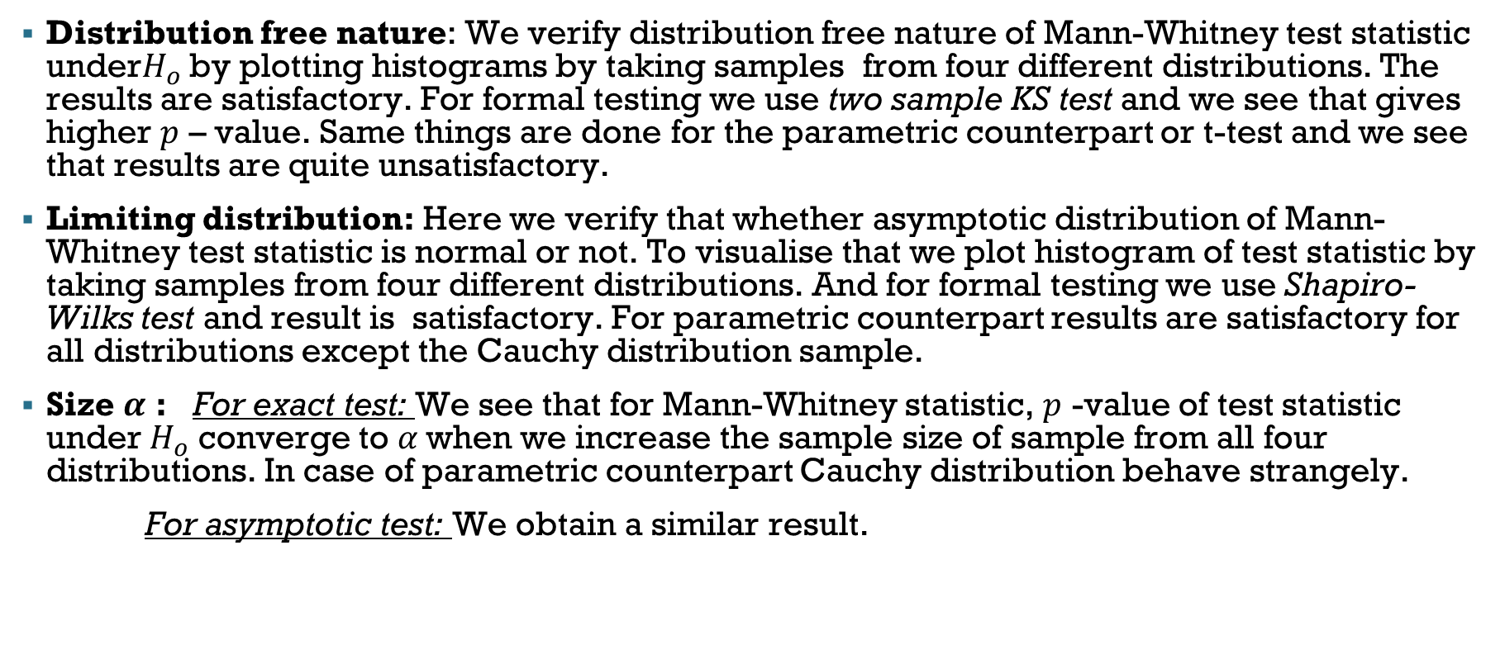
CONCLUSION
Distribution free nature: We verify distribution free nature of Mann-Whitney test statistic under$H_{o}$ by plotting histograms by taking samples from four different distributions. The results are satisfactory. For formal testing we use two sample KS test and we see that gives higher $p$ – value. Same things are done for the parametric counterpart or t-test and we see that results are quite unsatisfactory.
Limiting distribution: Here we verify that whether asymptotic distribution of Mann-Whitney test statistic is normal or not. To visualise that we plot histogram of test statistic by taking samples from four different distributions. And for formal testing we use Shapiro-Wilks test and result is satisfactory. For parametric counterpart results are satisfactory for all distributions except the Cauchy distribution sample.
Size $α$ : For exact test: We see that for Mann-Whitney statistic, $p$ -value of test statistic under $H_{o}$ converge to $α$when we increase the sample size of sample from all four distributions. In case of parametric counterpart Cauchy distribution behave strangely.
For asymptotic test: We obtain a similar result.

Slide 93
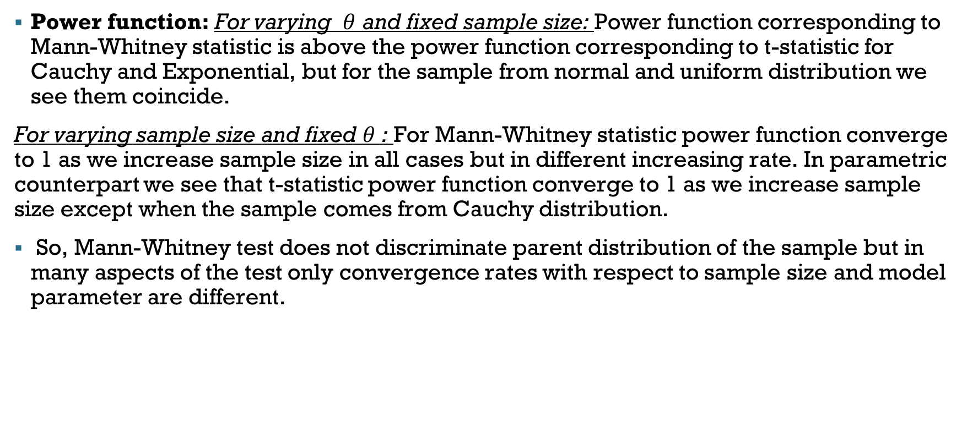
CONCLUSION
Power function: For varying $θ$ and fixed sample size: Power function corresponding to Mann-Whitney statistic is above the power function corresponding to t-statistic for Cauchy and Exponential, but for the sample from normal and uniform distribution we see them coincide.
For varying sample size and fixed $θ$ : For Mann-Whitney statistic power function converge to 1 as we increase sample size in all cases but in different increasing rate. In parametric counterpart we see that t-statistic power function converge to 1 as we increase sample size except when the sample comes from Cauchy distribution.
So, Mann-Whitney test does not discriminate parent distribution of the sample but in many aspects of the test only convergence rates with respect to sample size and model parameter are different.

Slide 94
THANK YOU

